Slide 1
Pytorch Models in Production: TorchServe
JAHNAVI RUDRARAJU
50464467
jahnavir@buffalo.edu

Slide 2
Contents:
What is TorchServe?
Why TorchServe?
Installation of TorchServe
Modes of PyTorch Model Execution
TorchScript JIT: Tracing and Scripting
References

Slide 3
What is TorchServe?

Slide 4
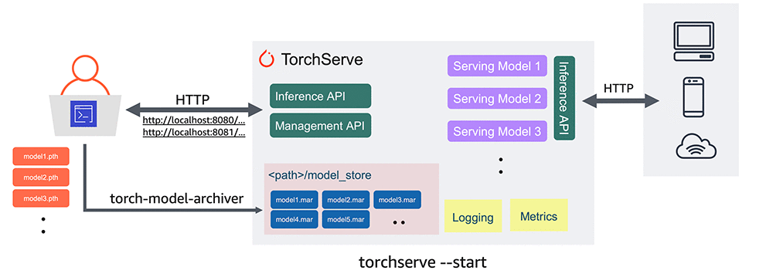
https://aws.amazon.com/blogs/machine-learning/deploying-pytorch-models-for-inference-at-scale-using-torchserve/

Slide 5
Why TorchServe?

Slide 6
Native PyTorch Support
CPU and GPU Support
RESTful APIs
Multi-Model Serving
Custom Services
Model Versioning
Model Packaging
Performance and Scalability
Integration with AWS Services
Open Source

Slide 7
Installation of TorchServe

Slide 8
Step 1: Clone the TorchServe Repository
git clone https://github.com/pytorch/serve.git
Step 2: Change directory and install dependancies
cd serve
python ./ts_scripts/install_dependencies.py
Step 3: Install required Python libraries
pip install torchserve torch-model-archiver torch-workflow-archiver
Details of Installation:
https://github.com/pytorch/serve/blob/master/docs/getting_started.md

Slide 9
Modes of PyTorch Model Execution

Slide 10
Eager Execution Mode
Good for training/prototyping/debugging
Python runtime is required
Slower inference
Flexible for applying different modelling techniques
Can use any of the Python libraries
Script Mode
Model runs in graph execution mode, optimized for speed
Can be loaded in other languages, requires only C++ runtime
Uses TorchScript, which is intermediate representation of PyTorch Model
Doesn’t support everything supported by Python/ eager execution

Slide 11
TorchScript JIT: Tracing and Scripting

Slide 12
Tracing
Does not support any data structures or control flow statements like if/else, for loop from Python
Requires sample input to generate the trace of operations
Scripting
Supports any data structures or control flow statements like if/else, for loop from Python
Requires only model

Slide 13
Example

Slide 14
References

Slide 15
Torchserve Documentation https://pytorch.org/serve/
TorchServe Github Repo https://github.com/pytorch/serve
How to Serve PyTorch Models with TorchServe https://www.youtube.com/watch?v=XlO7iQMV3Ik&ab_channel=PyTorch
Deploying PyTorch models for inference at scale using TorchServe https://aws.amazon.com/blogs/machine-learning/deploying-pytorch-models-for-inference-at-scale-using-torchserve/

Slide 16
Thank You!

